Slide 1
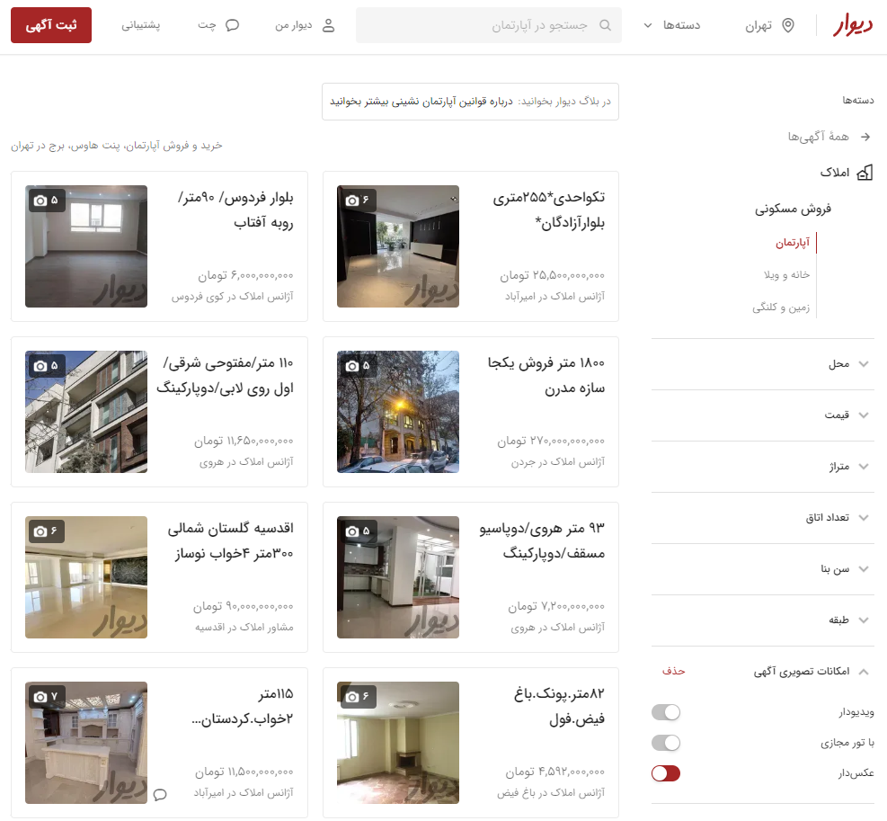


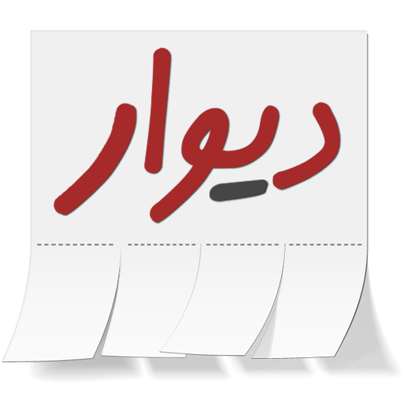
Divar Real Estate Posts Analysis
Descriptive Analysis Project Data Analytics Course
Mohsen Fayyaz
Dec. 2022

Slide 2
The importance?
Divar posts are one of the best indicators of the real and up to date state of society
The Real Estate category of posts is the most important category
We can find interesting and counterintuitive results in them

Slide 3
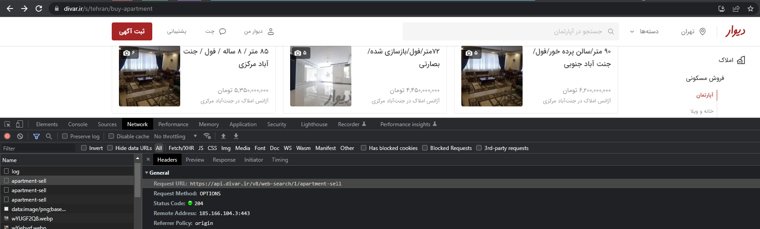
Data Collection (Scraping)
Explored the website and network logs
Found an API to use

Slide 4
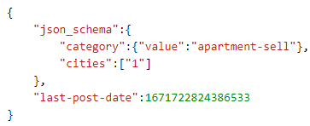
Data Collection (Scraping)
Explored the website and network logs
Found an API to use
Each API call returns 24 posts. I called the API for 1000 times (30min) and acquired 24,000 unique posts.
https://github.com/mohsenfayyaz/data-analytics-course-ut/blob/main/Project_EDA/divar_apartment_sell_24000.csv
https://api.divar.ir/v8/web-search/1/apartment-sell

Slide 5
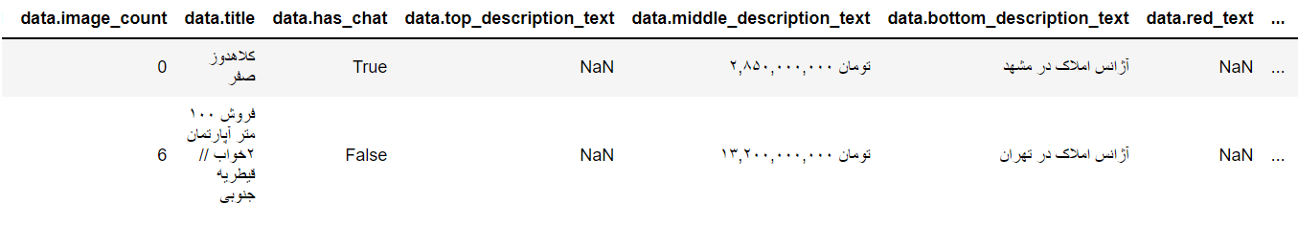
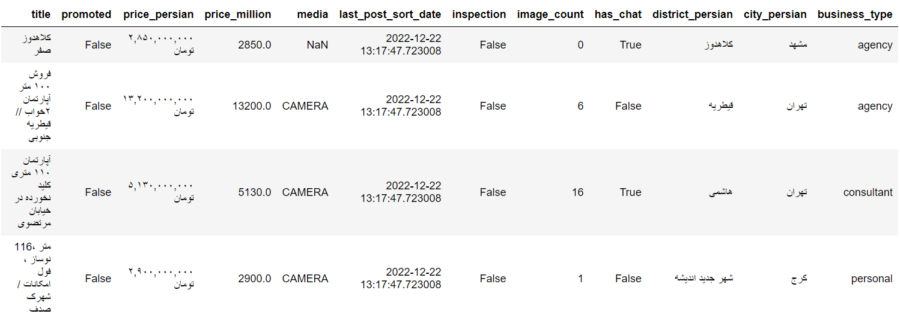
Data Collection (Cleaning)
Dropped columns with no information (Like having only one value)
Converted persian text of “۲,۹۰۰,۰۰۰,۰۰۰ تومان” to integer numbers.
Extracted business type (آژانس املاک / مشاور املاک / شخصی) from texts like “مشاور املاک در تهران”
Extract promoted status based on a red text “فوری”
Convert epoch time to pandas datetime
Renamed column names
Data Cleaning

Slide 6
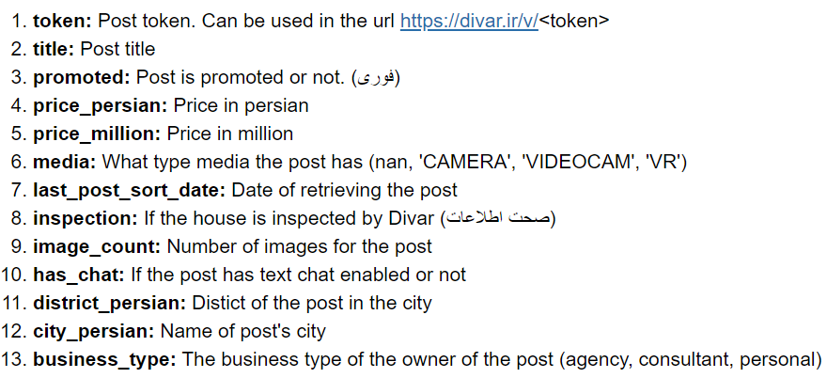
Data Collection (Cleaning)
Final Scraped and Cleaned Dataset (2022-12-22)

Slide 7
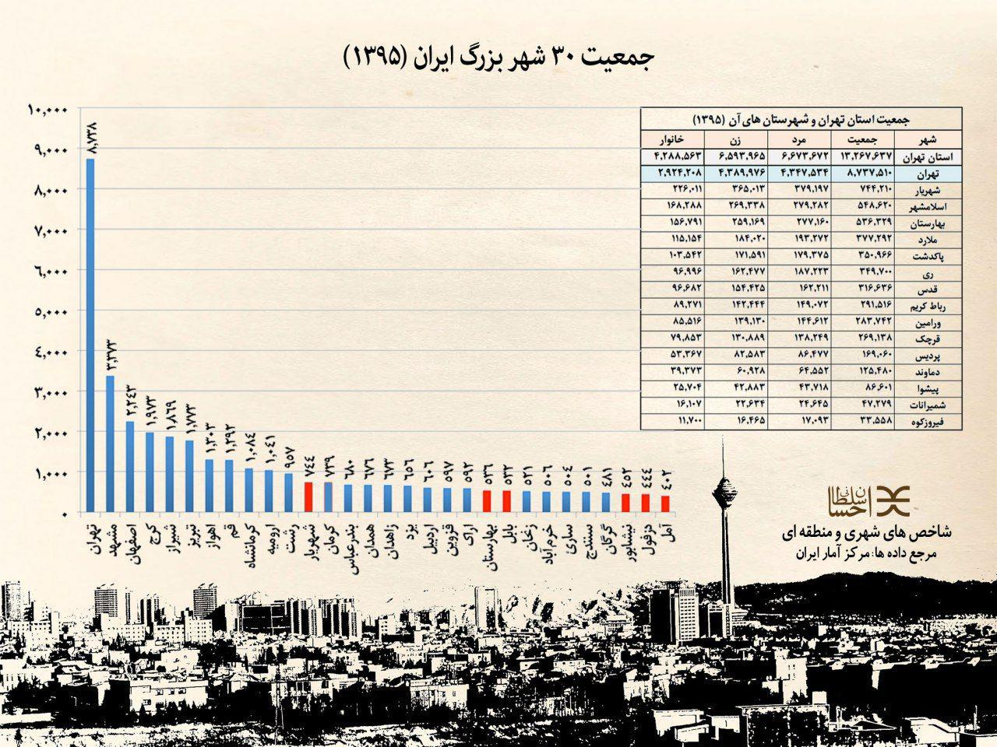
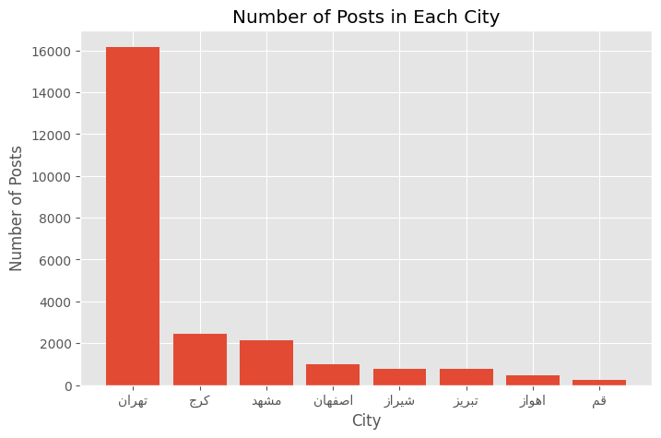
Number of Posts in Cities
The order of cities is similar to the population of cities based on census of 1395 (Except Karaj)

Slide 8
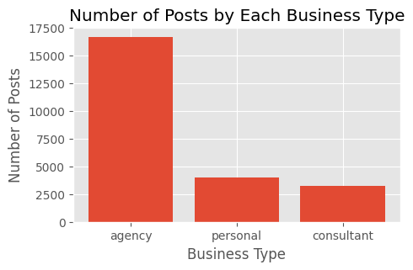
Business Types
Agencies post most of the posts on Divar real estate category.

Slide 9
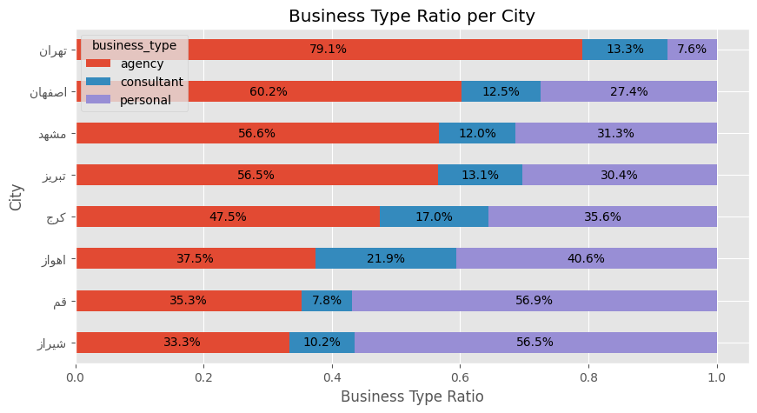
Business Types
Agencies post most of the posts on Divar real estate category.
Is above True in every city? No

Slide 10
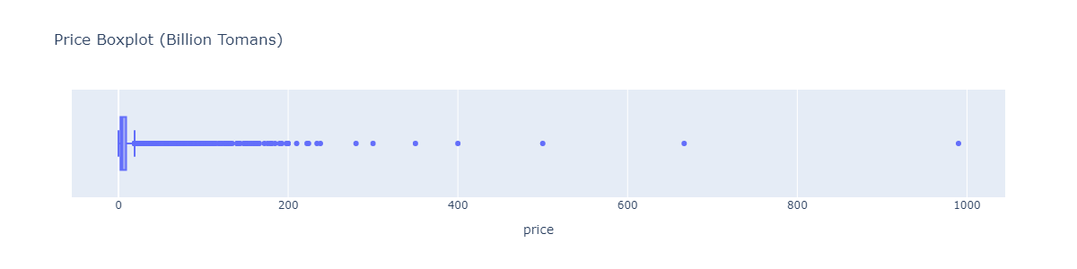
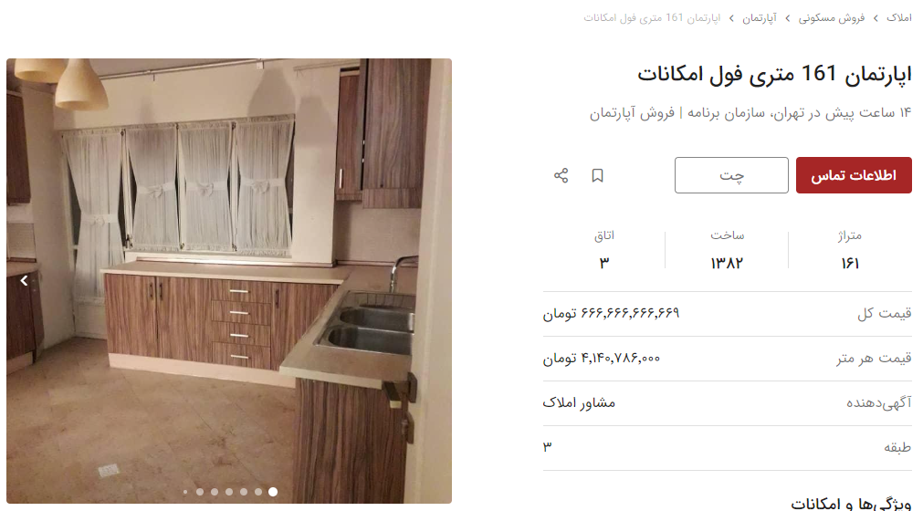
Price Outliers
Mistake

Slide 11
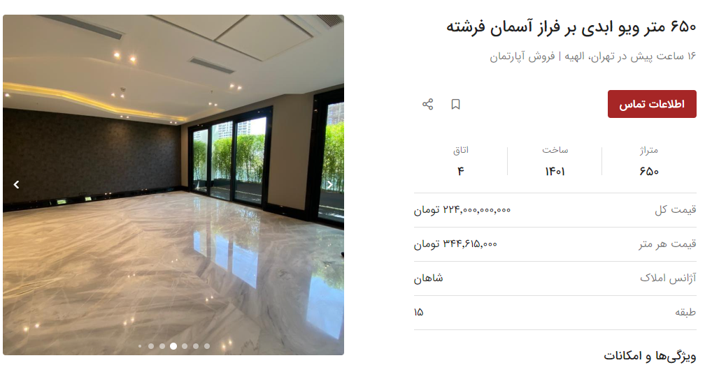
Price Outliers
Expensive

Slide 12
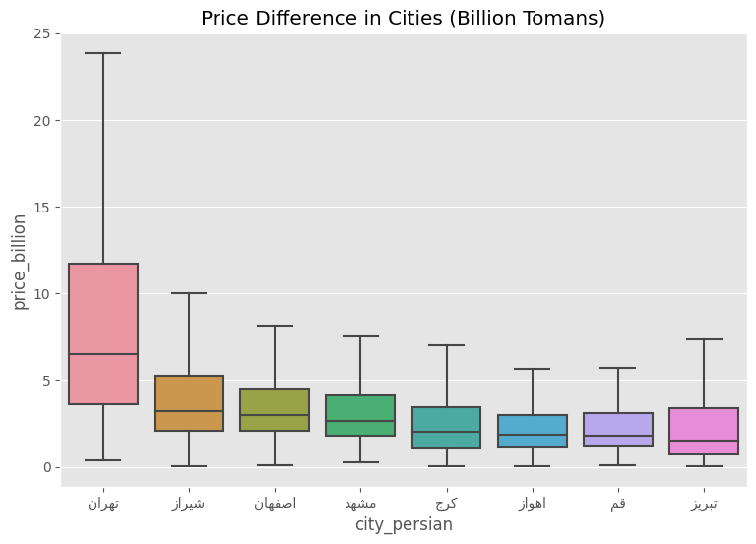
Price in Cities
Tehran has the highest prices, mostly ranging from 4B to 12B Tomans.

Slide 13
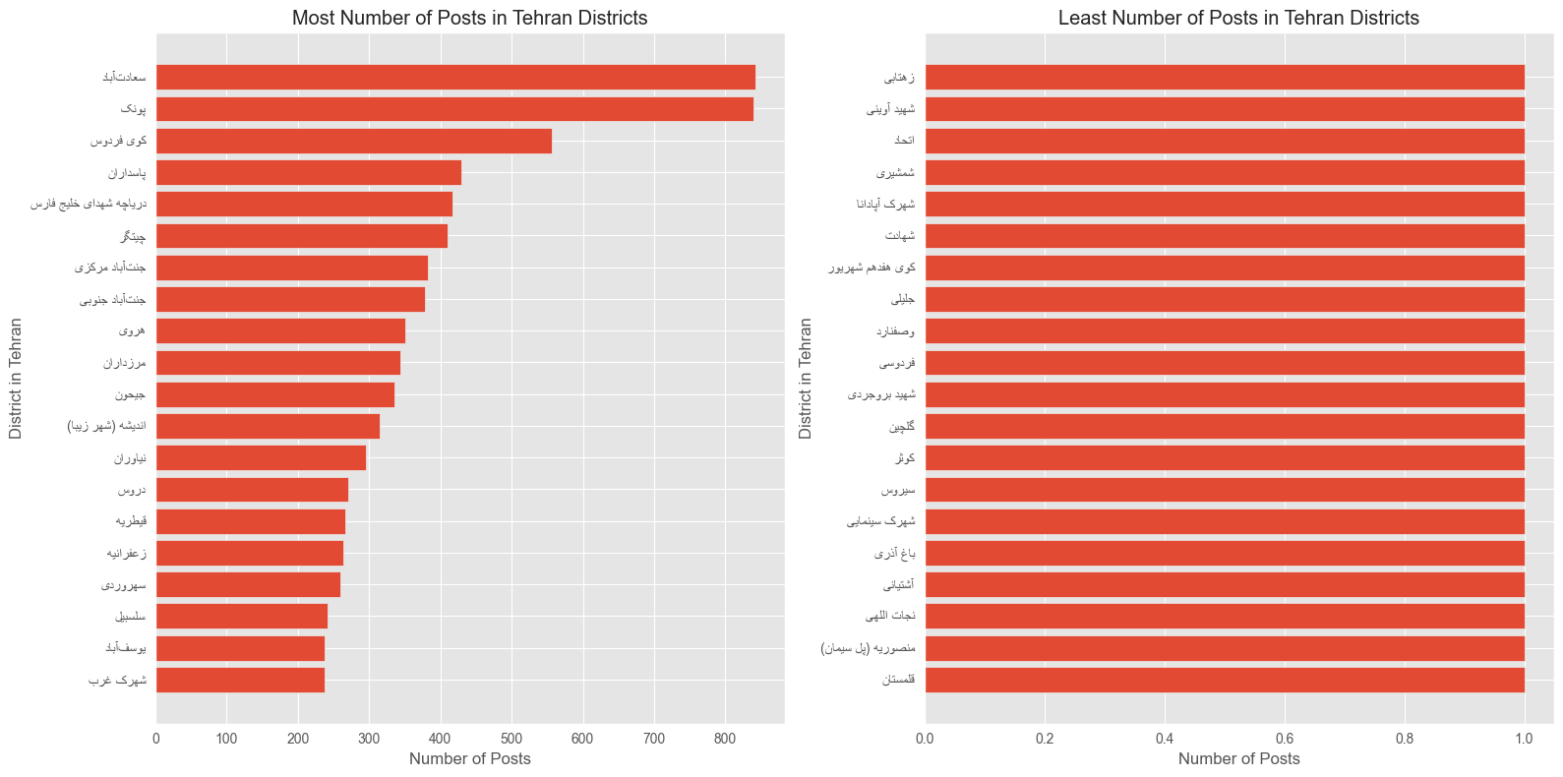
Number of Posts in Tehran Districts
Most posts are first in Sadat Abad and Punak at District 2. There are also many posts at west of Tehran such as Chitgar Lake and Jannat Abad.

Slide 14
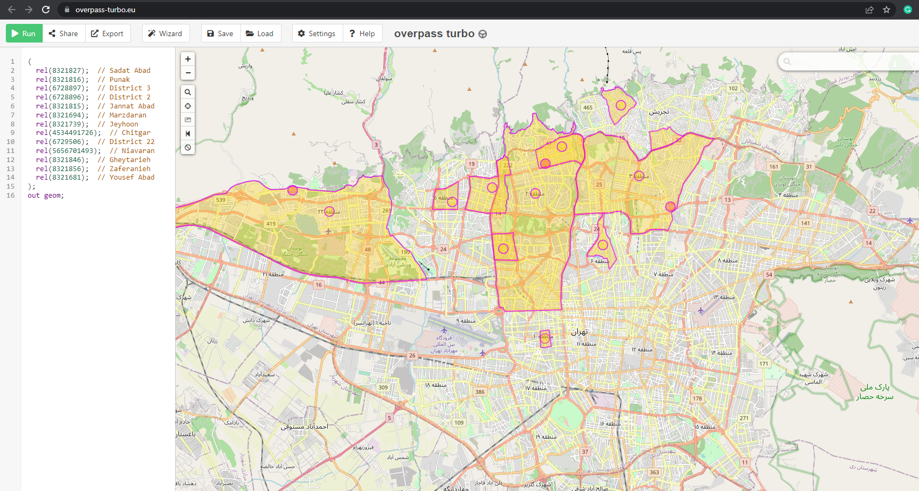
Number of Posts in Tehran Districts (Map)
we use openstreetmap.org and overpass-turbo.eu
North and West of Tehran are the most active areas in real estate.

Slide 15
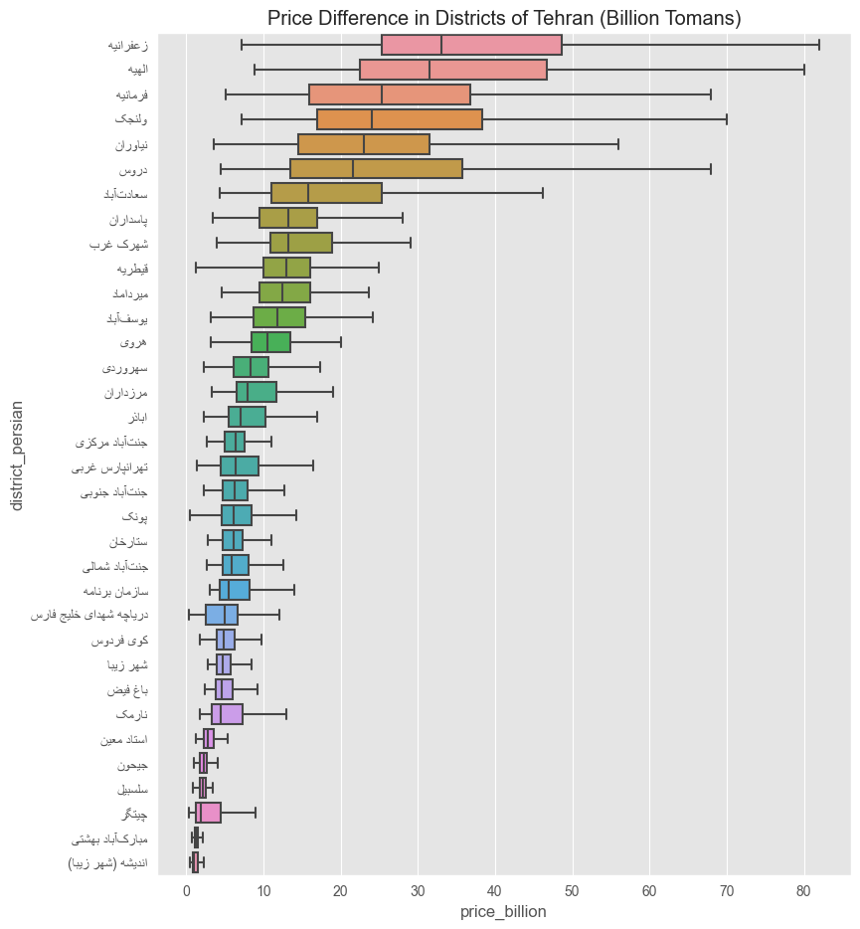
Price in Tehran Districts
We include the districts which have more than 150 posts.
Zaferanieh, Elahie, Farmanie, Velenjak, ... have the highest overall prices.
Andishe, Chitgar, and Salsabil have the least prices.

Slide 16
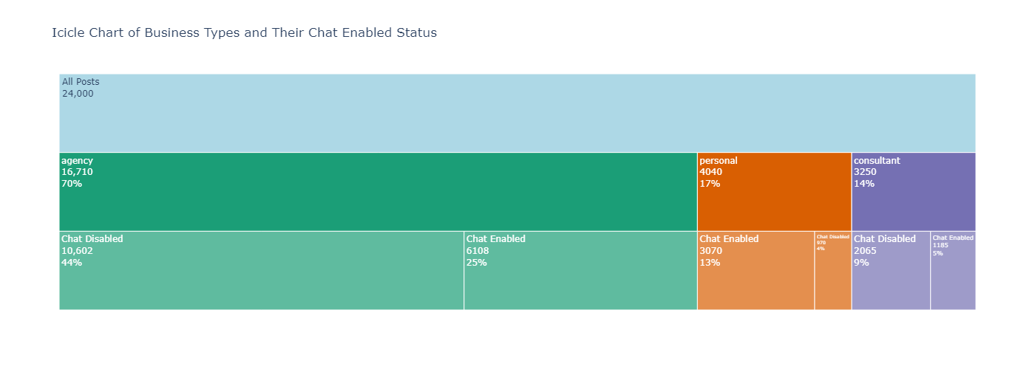
Chat Enabled
Agencies tend to disable the text chat ability in Divar (38% enabled)
Personal accounts mostly make their chats enabled (76% enabled)
Agencies want to talk directly to the customer because it is faster to convey more information, and they can introduce and sell more cases over phone.
Personal accounts might get disturbed by calls and prefer to text.

Slide 17
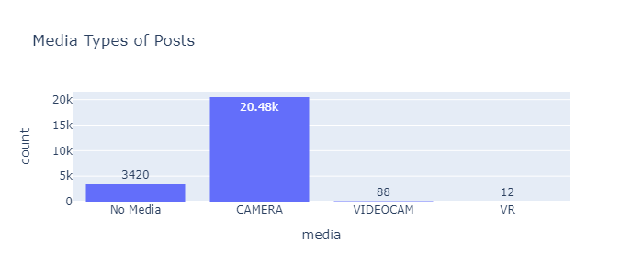
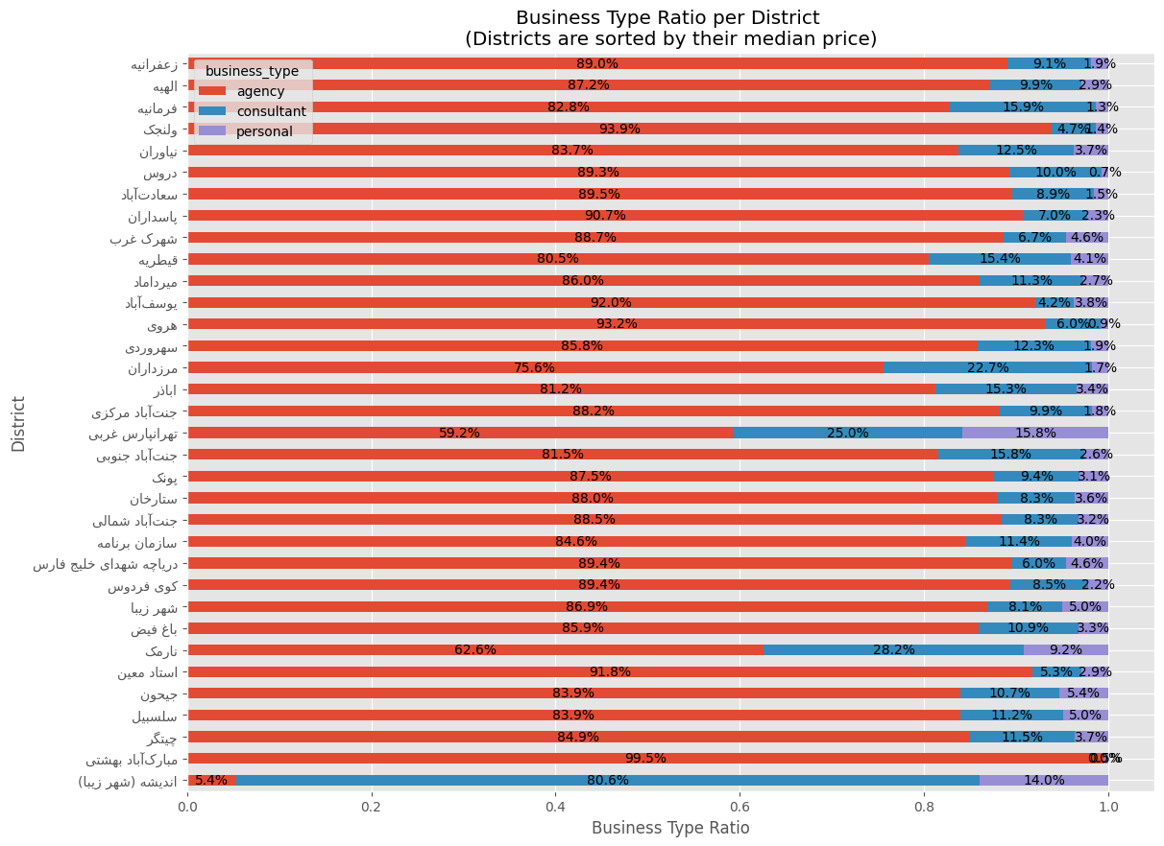
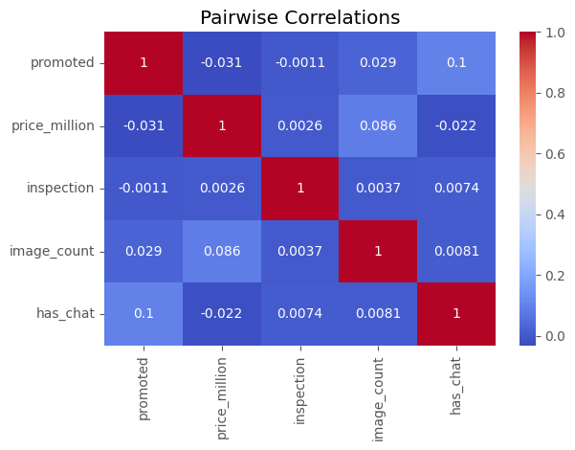
More …
There are more analysis on Promotion, Correlations, Media, … in the jupyter notebook
https://github.com/mohsenfayyaz/data-analytics-course-ut/blob/main/Project_EDA/divar_eda.ipynb

Slide 18
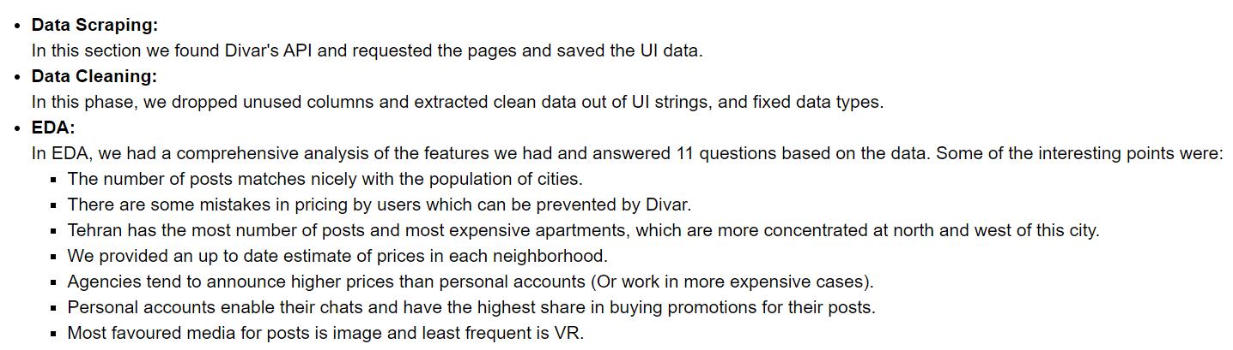
Summary

Slide 19

THANK YOU!
mohsen.fayyaz77@ut.ac.ir
https://mohsenfayyaz.github.io/
CREDITS: This presentation has partially included entities from templates created by SLidesgo, including icons by FLaticon, and infographics & images by Freepik
Notes:
Thanks for your listening.

Slide 20
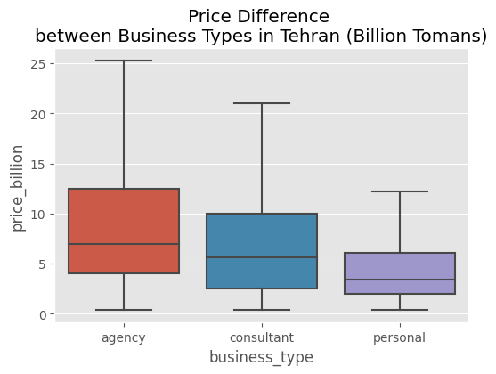
Price per Business Type
Agencies provide the highest prices
Personal accounts set the cheapest prices

Slide 21
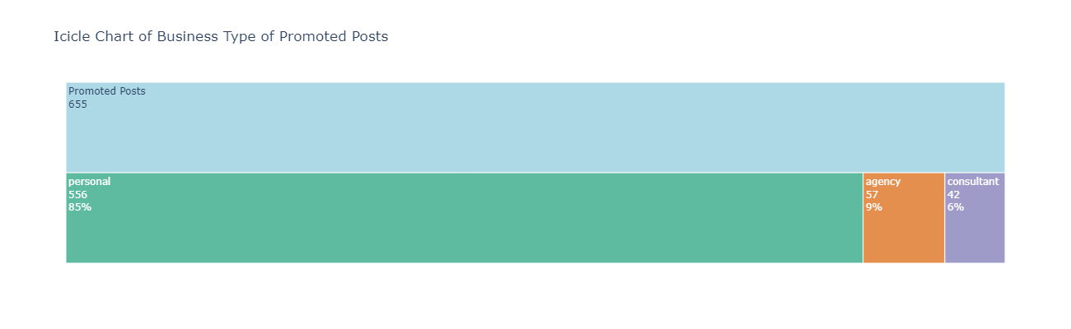
Promotions
Only 3% of the posts were paid to be promoted (فوری)
Personal accounts significantly buy more promotions than agencies

